Slide 1
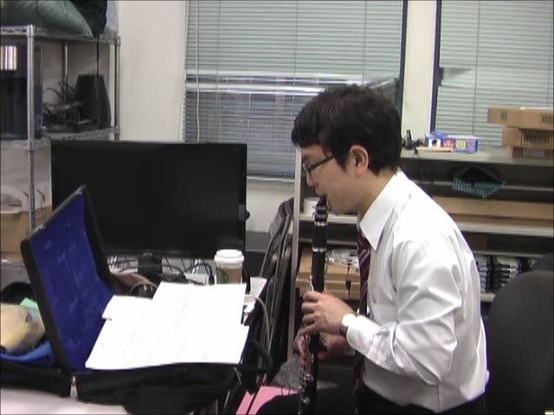
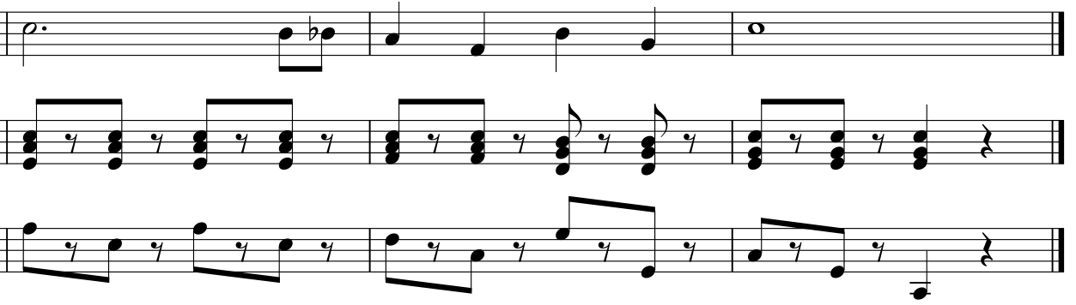
Demo: Human Performance with Deletion Error
Do-Re-Mi
(show tune)
Automatic accompaniment system keeps following the performance with deletion error.
Score
Solo part
Deletion error
Notes:
Click the movie (NOT PLAY BUTTON).

Slide 2
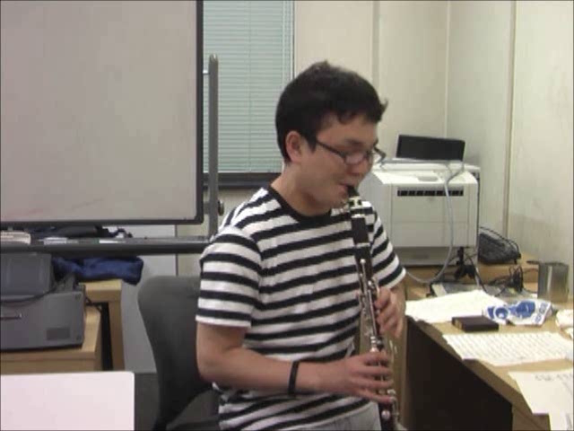
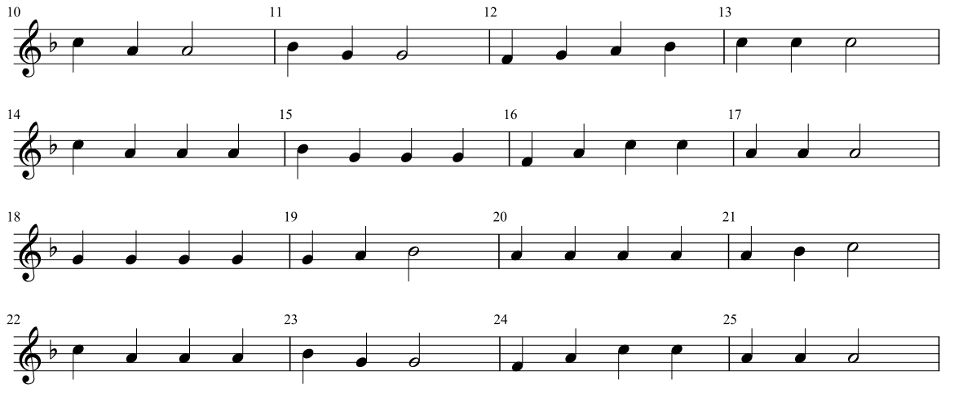
Demo: Human Performance with Repeat
Repeat
Score
Hänschen klein
（folk song, RWC-R001）
Automatic Accompaniment system keeps following the performance after the repeat.
Notes:
Click the movie (NOT PLAY BUTTON).

Slide 3
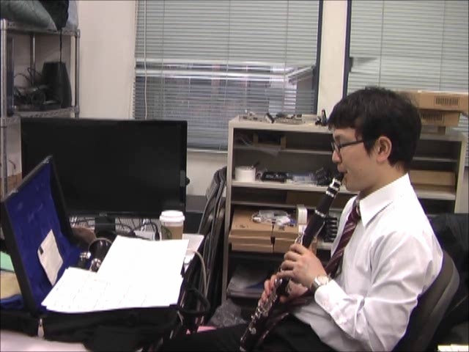
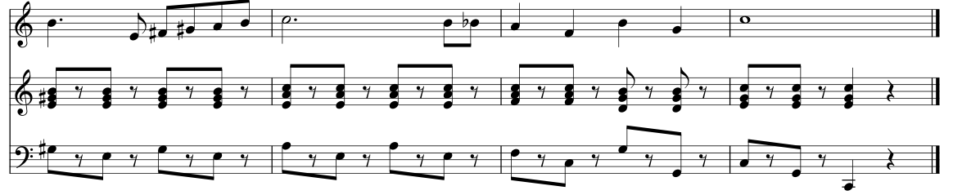
Demo: Human Performance with Repeat and Deletion Error
Do-Re-Mi
(show tune)
Automatic accompaniment keeps following the performance with a repeat and a deletion error.
Deletion error
Solo part
Repeat from here
Score
Notes:
Click the movie (NOT PLAY BUTTON).

